Slide 1
Neurodegenerative Disease and the Eye
Alexa Moy, OD and Charles Johnson, OD
Residents Optometry

Slide 2
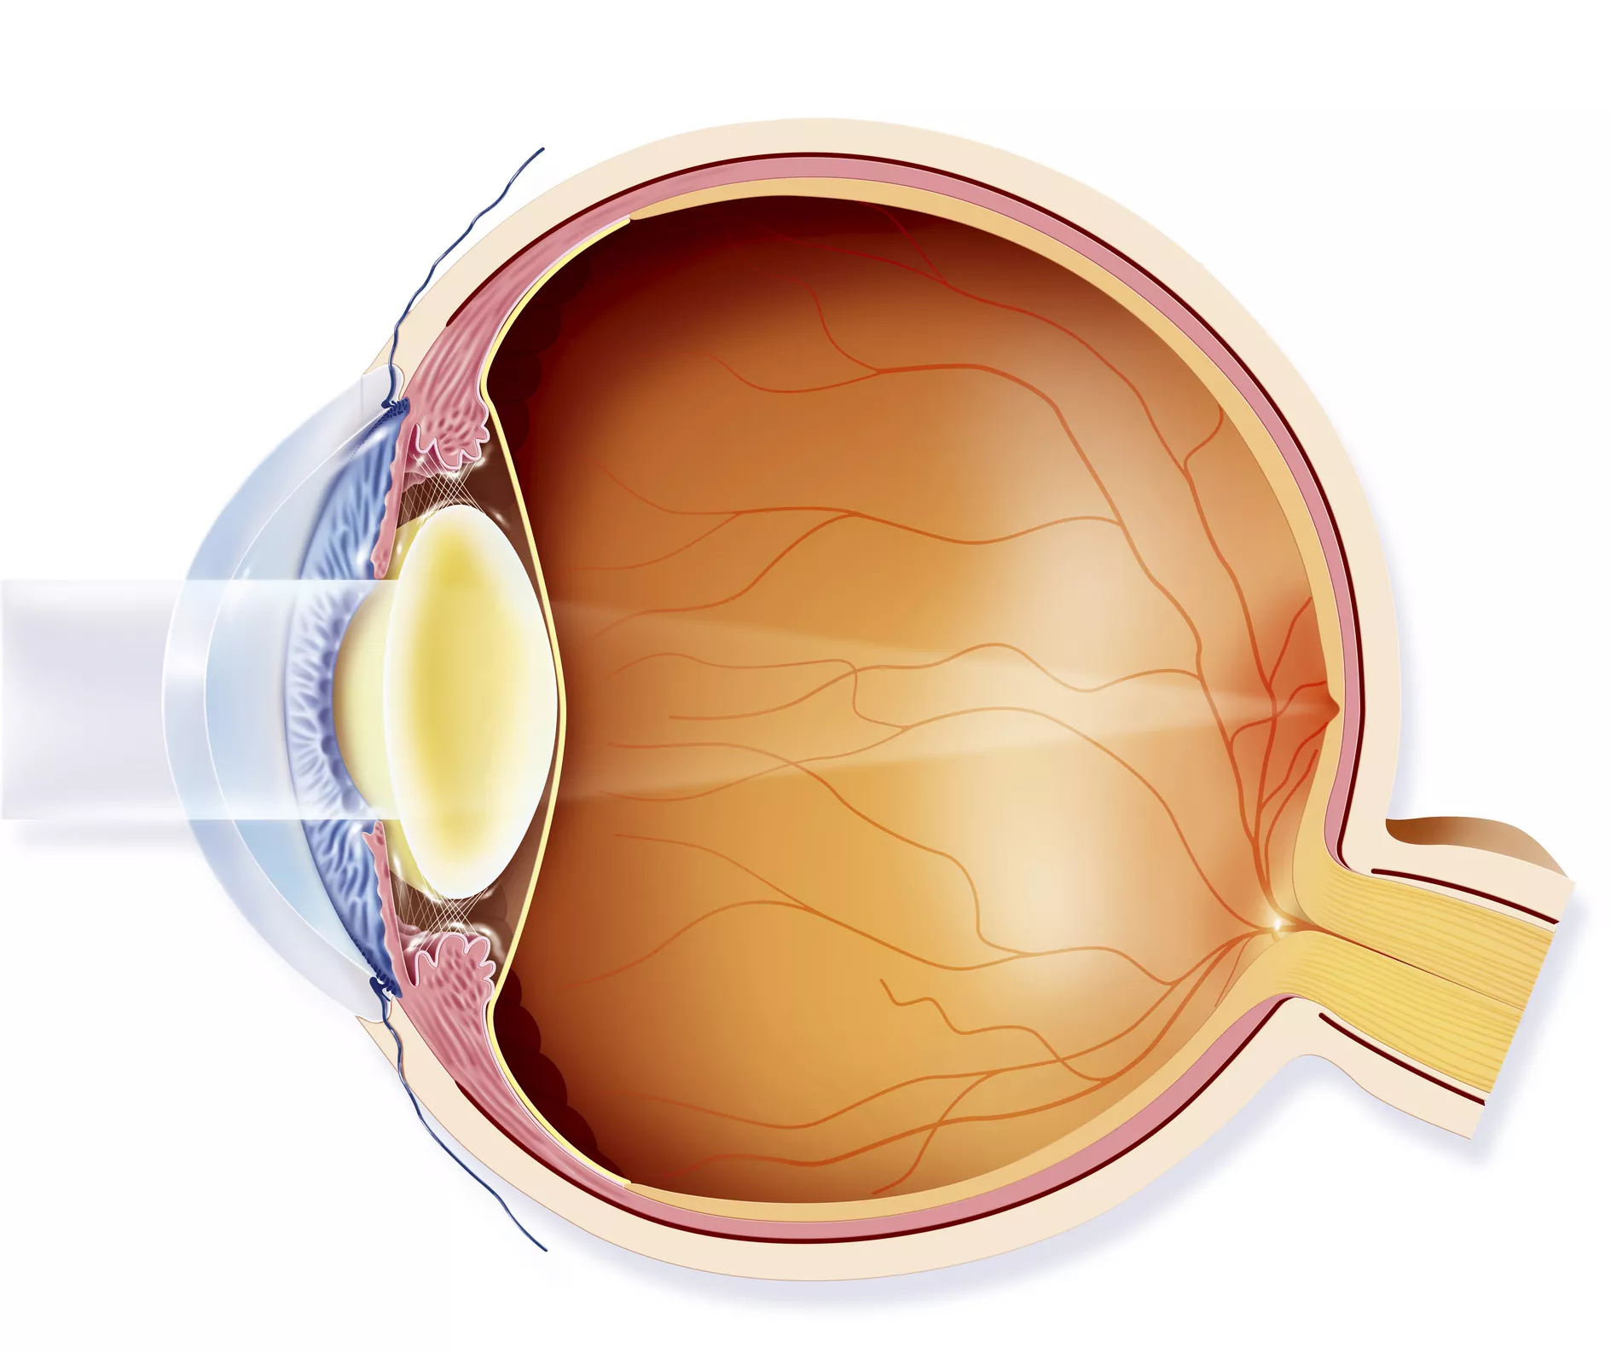
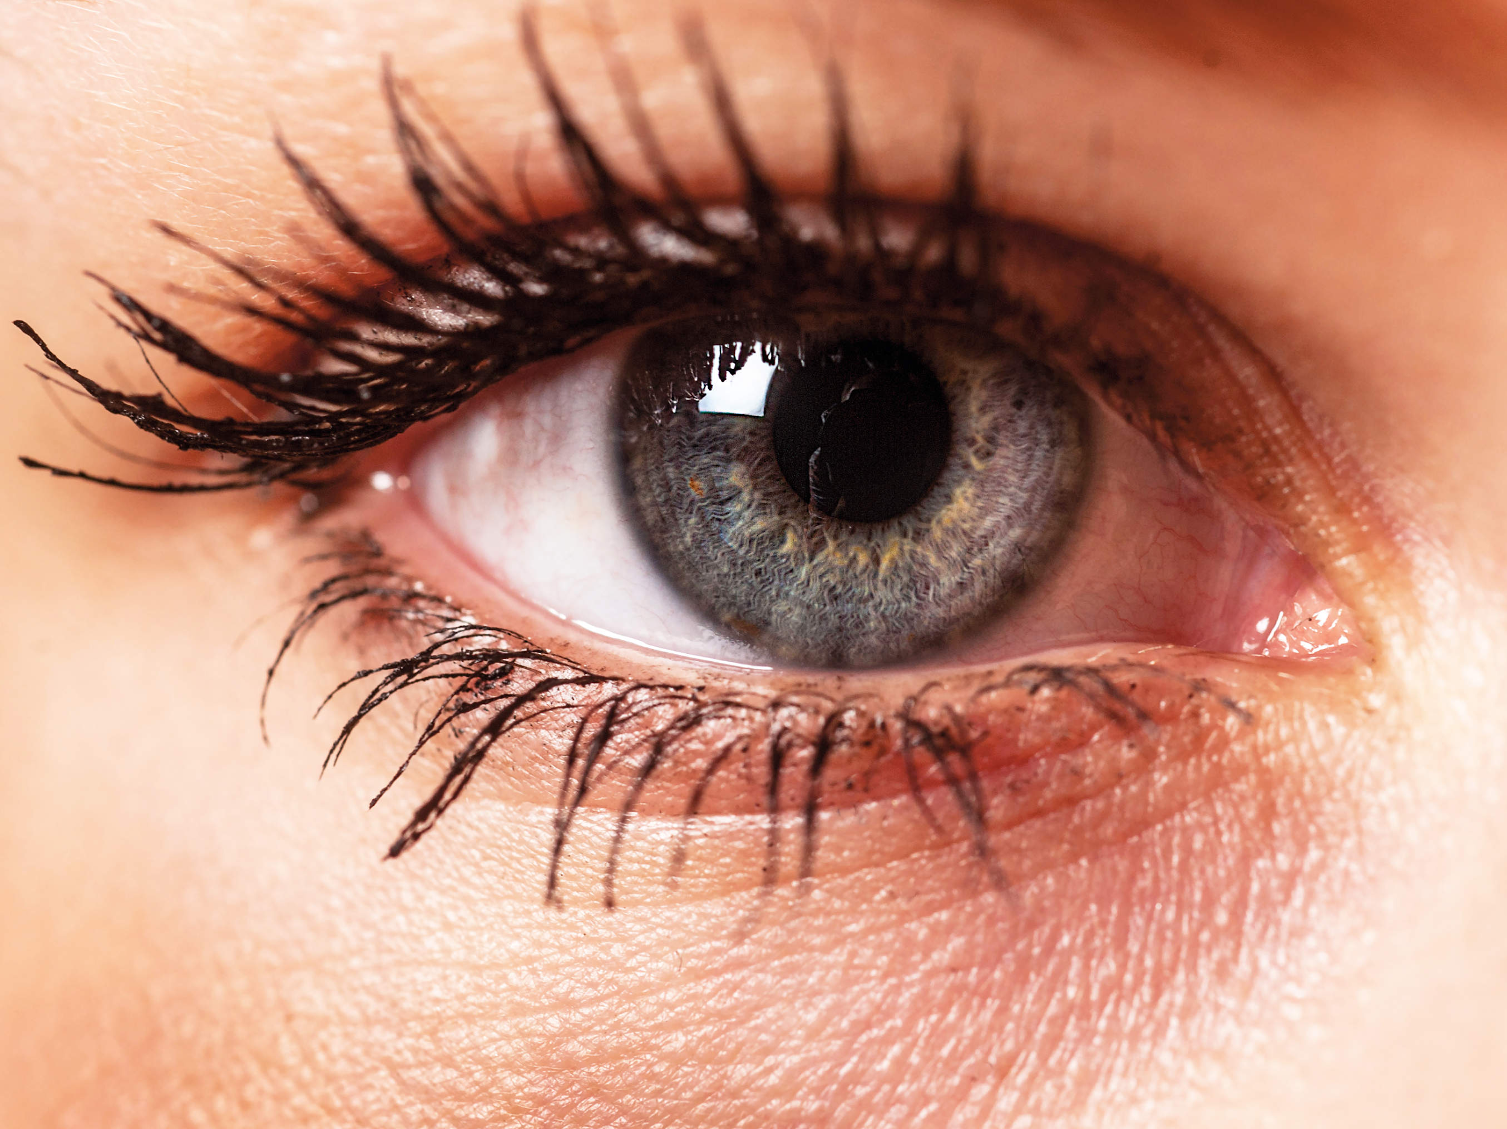
Eye Anatomy Review
Anatomically, the retina develops from the same embryologic layer as the rest of the central nervous system.
The cells in the retina serve the purpose of capturing light and refining that information as it is transmitted back to the visual cortex
This makes it unique in that it is part of the central nervous system that can easily and non-invasively imaged.
Notes:
Image source (top): https://www.verywellhealth.com/anatomy-of-the-eye-4020421
Image source (bottom): https://www.health.com/condition/eye-health

Slide 3
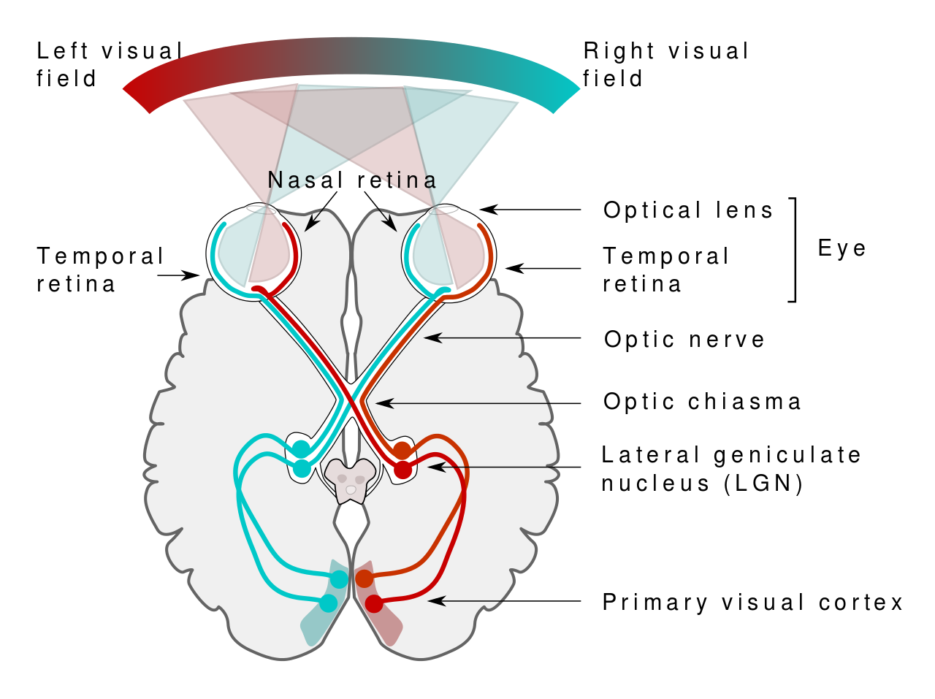
Visual Field Pathway
The light information collected by the retina is transmitted to the visual cortex of the brain, located in the occipital lobe before being passed on to other areas of the brain for further processing.
The visual field information is transmitted
such that the right visual field information
is sent to the left occipital lobe and the left
visual field is sent to the right occipital lobe.
This pathway from the retina to the visual
cortex is composed of two sets of neurons
that synapse in the lateral geniculate nucleus
(LGN).
Notes:
Image source: https://commons.wikimedia.org/wiki/File:Human_visual_pathway.svg

Slide 5
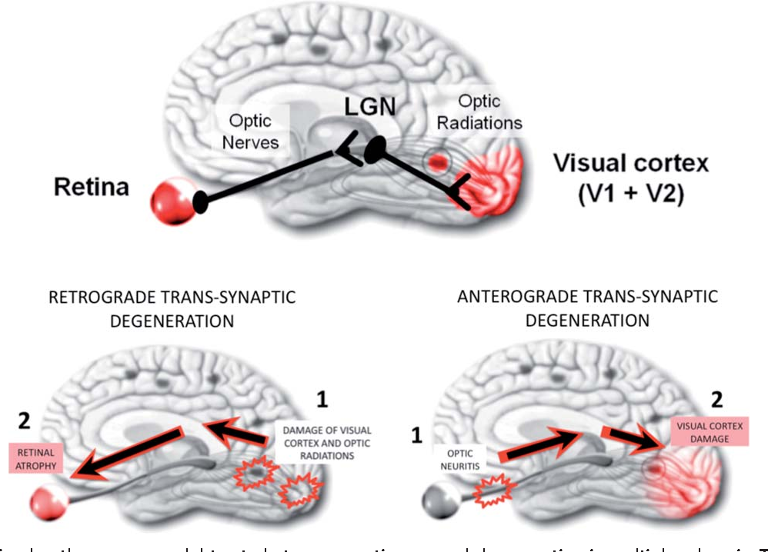
Trans-Synaptic Degeneration
Death of neurons can lead to subsequent death of neurons with which they synapse.
This can happen in either direction, either from the retina back to the visual cortex (anterograde) or from the cortex forward to the retina (retrograde).
Notes:
Image source: Gabilondo, Iñigo et al. “Trans-synaptic axonal degeneration in the visual pathway in multiple sclerosis.” Annals of neurology 75 1 (2014): 98-107 .

Slide 6
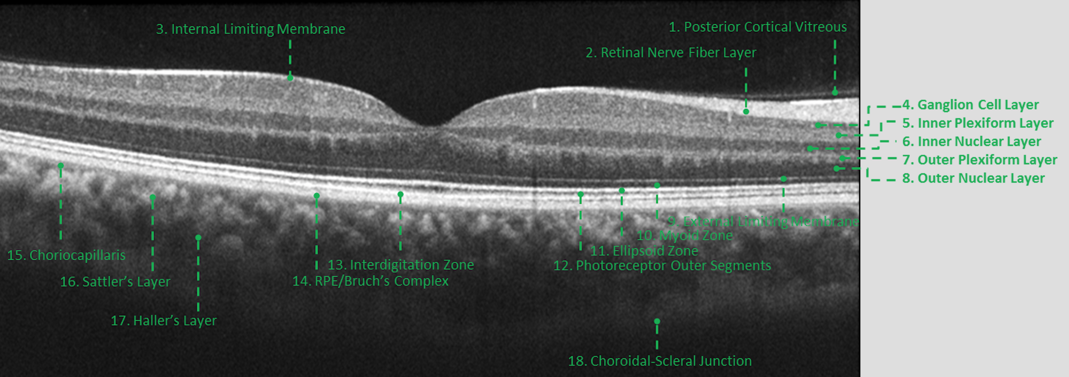
Ocular Coherence Tomography
Allows for three dimensional look at the retina and its structure.
Shown below is an image outlining the various layers of the retina, looking at a slice through the fovea, the anatomical center of the retina.
Notes:
Image source: Mohandass G, Natarajan R. A, Sendilvelan S. Retinal Layer Segmentation in Pathological SD-OCT Images Using Boisterous Obscure Ratio Approach and its Limitation. Biomed Pharmacol J 2017;10(3).

Slide 8
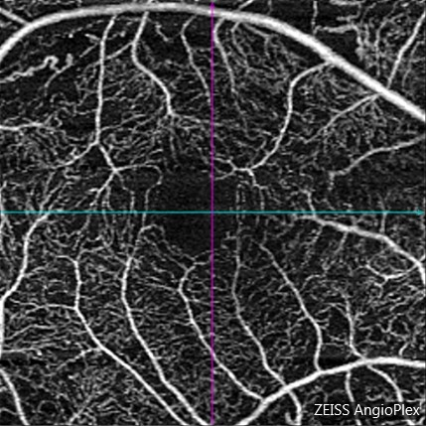
OCT Angiography
A relatively new imaging modality that allows us to visualize the vascular structure within the retina.
It allows us to look for areas of focal ischemia within the retina, as well as look for areas of neovascularization that may be due to certain disease processes

Slide 9
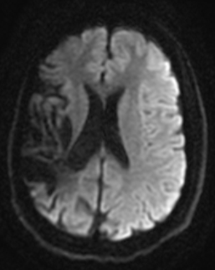
Retrograde Degeneration Example
Post-stroke
Encephalomalacia (loss of brain tissue)
Right parietal, temporal, and frontal lobe

Slide 11
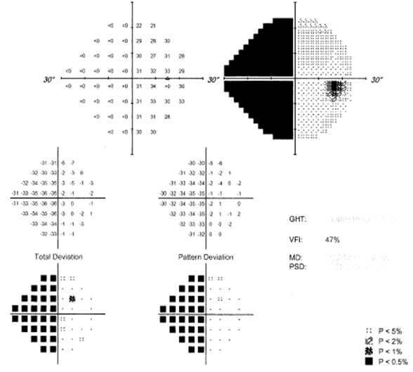
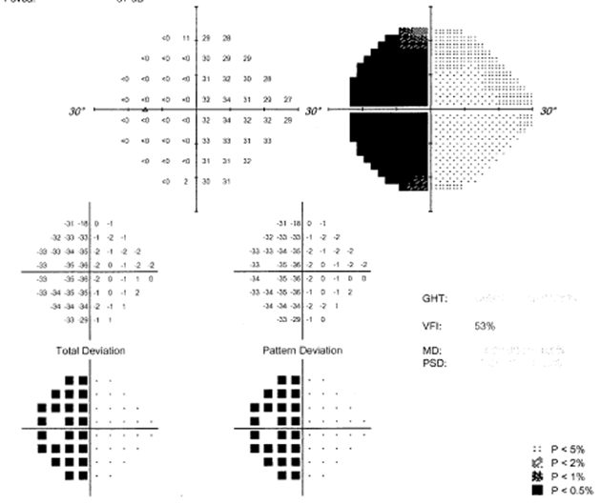
Visual Field

Slide 12
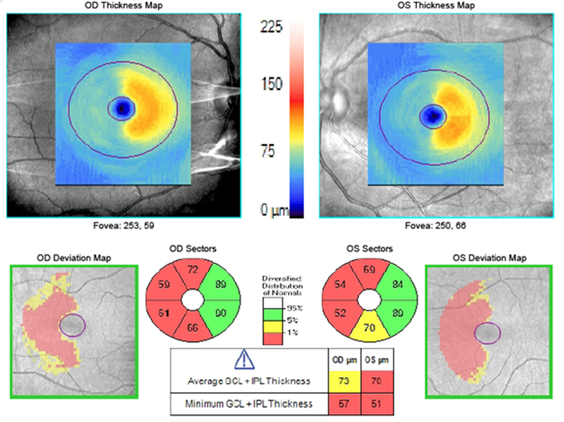
Ganglion Cell Analysis
Inner plexiform and ganglion cell layer

Slide 13
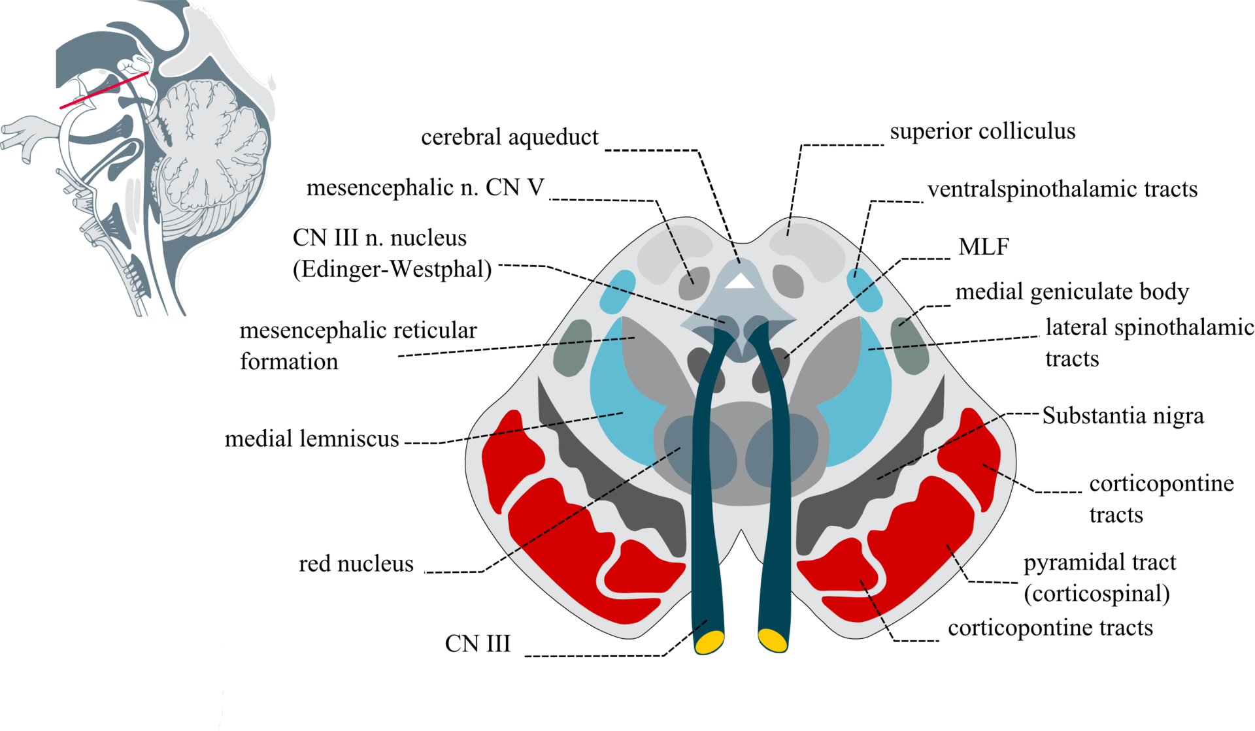
Parkinson’s
Neurodegenerative disease characterized by loss of nerve cells in the substantia nigra of the midbrain and accumulation of α-synuclein (Lewy bodies).
Loss of dopaminergic cells → reduction in production of dopamine and loss of function.

Slide 14
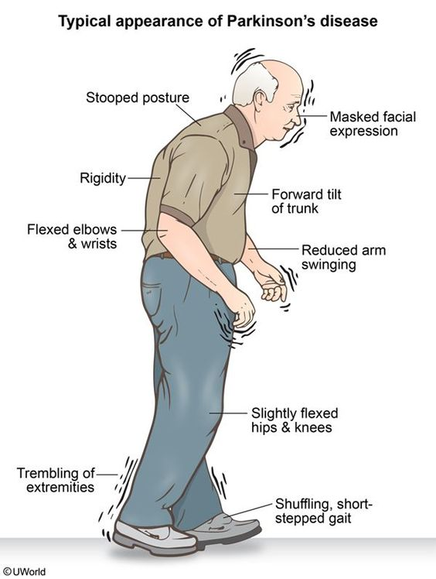
Parkinson’s Systemic
Changes in motor skills
Muscle rigidity and difficulty initiating voluntary movements
Slow movements
Poor balance and shuffling gait
Tremors, “Pill rolling” of the hands
Cognitive impairment in later stages

Slide 15
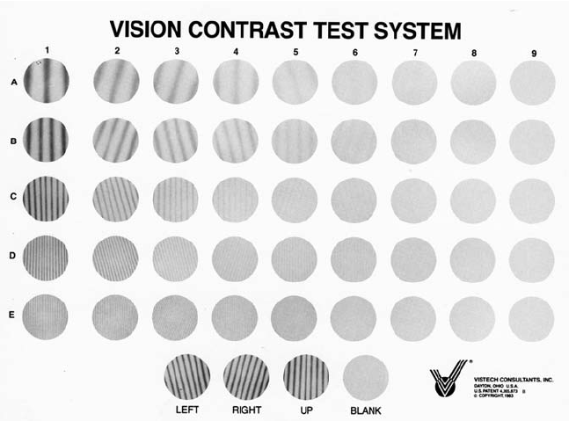
Parkinson’s: Visual Symptoms
Altered color vision
Often reported as reduced vibrancy or more dull appearance
Reduced contrast sensitivity.
Reduced visual acuity

Slide 16
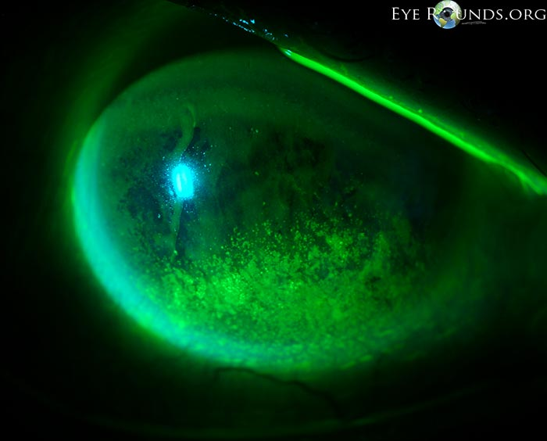
Parkinson’s: Ocular Findings
Difficulty with eye movements
Square wave jerks: back and forth eye movements, difficulty fixating.
Reduced voluntary saccades
Decreased blink reflex
Can lead to severe dryness which can further exacerbate reduced acuity
Reduced visually evoked potential, which measures electrical signals reaching the occipital lobe.
Notes:
Picture Source: http://webeye.ophth.uiowa.edu/eyeforum/atlas/pages/punctate-epithelial-erosions/index.htm

Slide 17
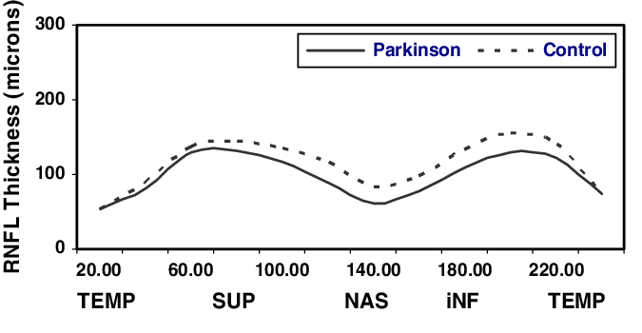
Parkinson’s: OCT findings
Reduced
Foveal thickness
Retinal nerve fiber layer thickness
OCT angiography: decreased microvascular density of superficial vessels
No current databases for comparison, future research is needed to more effectively screen using this device
Notes:
Image source: https://www.researchgate.net/figure/Normal-and-Parkinson-patients-RNFL-thicknesses-in-all-quadrantsP-005_fig1_5882957
OCT-A: https://www.ncbi.nlm.nih.gov/pubmed/?term=Retinal+Microvascular+Impairment+in+the+Early+Stages+of+Parkinson%27s+Disease.

Slide 18
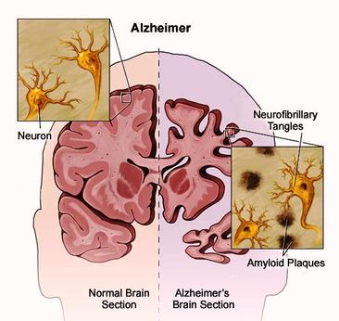
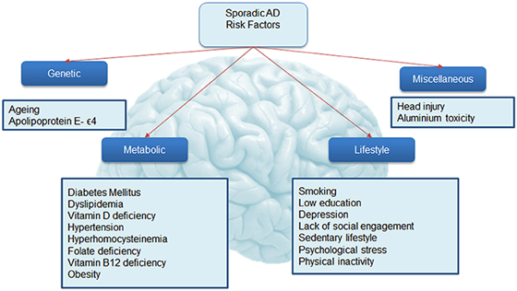
Alzheimer’s
B-amyloid plaques and tau tangles
Hippocampus, amygdala and basal nucleus of Meynert
Most common cause of dementia
Affects 5.7 million Americans age 65 and older with projections estimating 13.8 million affected by 2050

Slide 19
Alzheimer’s: Systemic
Memory loss
Compliance with prescribed treatment plan
Language loss
Difficulty communicating
Impaired judgement
Hearing – early marker
Physical functions
Swallowing
Balance
Bowel/bladder control

Slide 20
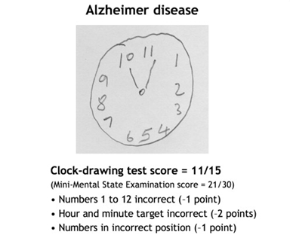
Alzheimer’s: Visual Symptoms
Visual memory loss
Visio-spatial disorganization (Clock dial test)
Color vision (blue hues)
Decreased depth perception
Crowding phenomenon - difficulty reading

Slide 21
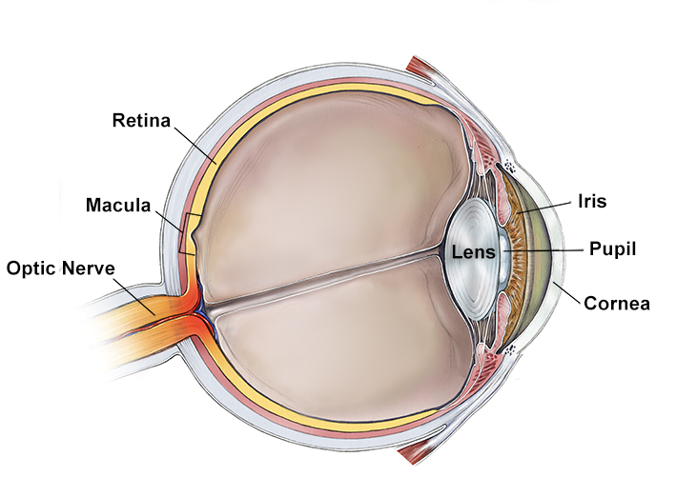
Alzheimer’s: Ocular findings
Eye movement:
increased latency initializing
decreased velocity
fixate/following
Cornea: impaired nerve growth factor
Lens: Aβ deposits
Notes:
increased latency when initializing voluntary eye movements, show decreased eye movement velocity, fail to fixate on a target or move in the wrong direction entirely and also fail to follow a moving target

Slide 22
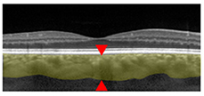
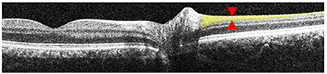
Alzheimer’s: OCT findings
Reduced
Choroidal thickness
RNFL (superior and inferior)
Retinal thickness of macula
Early stages of disease: inflammation/gliosis
Notes:
OCT-angio: vascular problems in AD include impaired Aβ clearance, reduced blood vessel density, smaller vessel diameter (vasoconstriction) and reduced blood flow

Slide 23
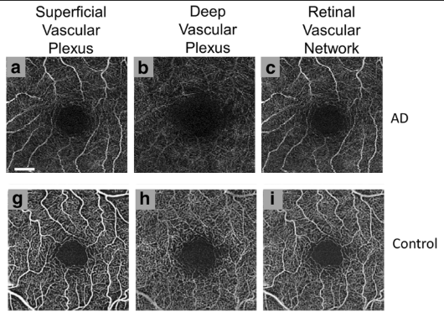
Alzheimer’s: OCT findings
OCT-angio: less density of superficial and deep retinal vascular networks; Enlarged FAZ
Mild cognitive impairment: RNFL
Early objective marker

Slide 24
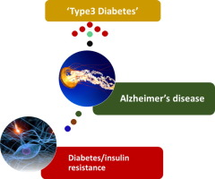
Alzheimer’s Disease and Diabetes
Speed of cognitive decline in DM is 2x as fast as normal aging
DM increases risk of MCI
Type 3 diabetes
Notes:
Pathway:
Impaired insulin signaling, inflammation, AGE products, oxidative stress

Slide 25
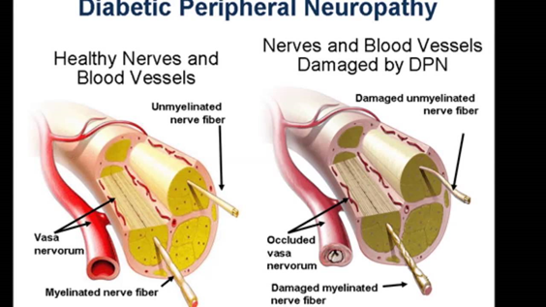
Diabetes
Body’s ability to produce or respond to the hormone insulin is impaired
Elevated levels of glucose
Peripheral neuropathy
Nerve damage caused by:
Advanced glycosylation end products (AGEs):
Vascular injury and hypoxia
Polyol pathway
Decreased nerve conduction
Microvascular damage
Ischemia and infarction
~30 million U.S. adults are living with diabetes
~10% of US population
~50% with diabetes have mild to severe forms of neuropathy

Slide 26
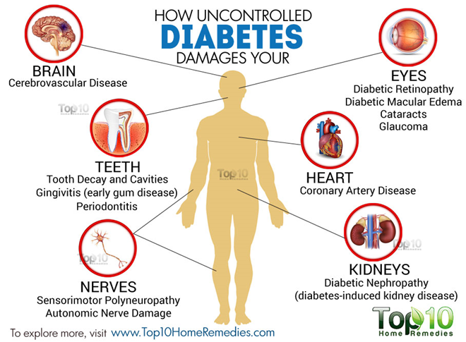
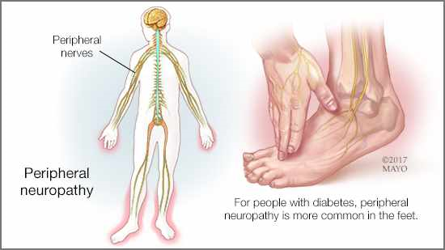
Diabetes: Systemic
Peripheral neuropathy
Touch sensitivity
Tingling/numbness
“pins and needles”
Muscle weakness
Balance problems

Slide 27
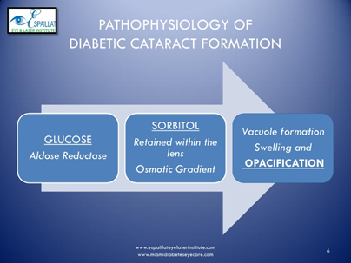
Diabetes: Visual Complications
Cataracts
Symptoms: blurry vision, glare, poor night vision, and reduced color vision
Glaucoma
40% more likely to suffer from glaucoma than people without diabetes
Progressive damage to the optic nerve
Symptoms: peripheral field loss

Slide 28
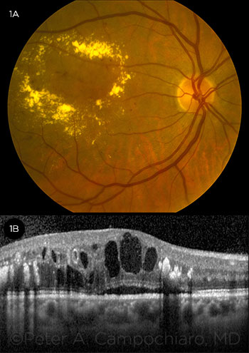
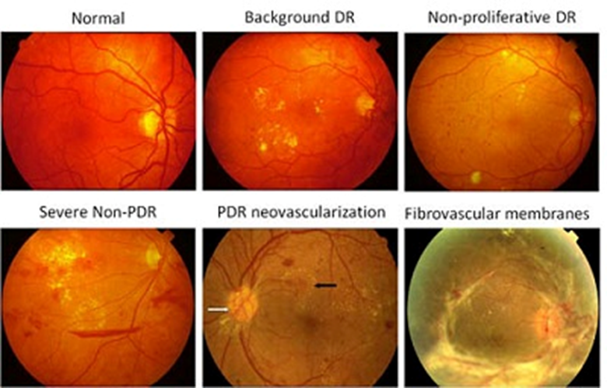
Diabetes: Visual Complications
Retinopathy

Slide 29
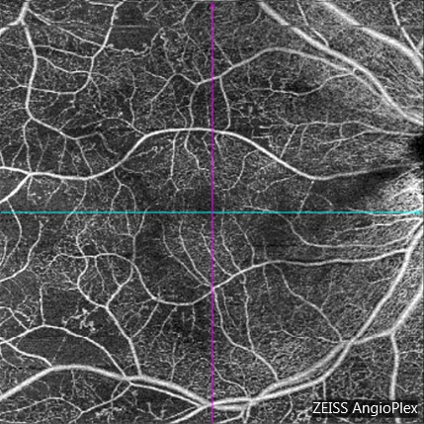
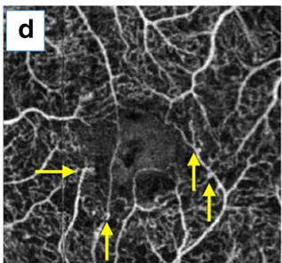
Diabetes: OCT Findings
Reduced
Perifoveal thickness (inner retina)
RNFL
OCT-angio: areas of non-perfusion, microaneurysms, and enlarged FAZ
Obesity:
Associated with global decreased RNFL
Notes:
Image source: Patient TK seen by G. Charles Johnson

Slide 30
Current Research
“Our findings indicate that the neurodegeneration continues multi-systemically and neurodegeneration increases simultaneously with the disease. OCT, which is a non-invasive [imaging] method, can be used as an indicator of neurodegeneration in patients with Parkinson’s Disease.
Assessment of Neurodegeneration by Optical Coherence Tomography and Mini–Mental Test in Parkinson’s Disease. Ann Indian Acad Neurol. 2019 Apr-Jun; 22(2): 212–216.
“Current research suggests a potential association between retinal findings observed on OCT and cognitive impairment.”
Application of Optical Coherence Tomography in the Detection and Classification of Cognitive Decline. J Curr Glaucoma Pract. 2018 Jan-Apr; 12(1): 10–18.

Slide 31
Current Research (continued)
“Structural and functional retinal changes have been suggested as the window to the neurodegenerative diseases. Retinal imaging is a non-invasive, cost-effective and highly promising method to study AD and provides new and additional important insights in AD.”
Potential Utility of Retinal Imaging for Alzheimer’s Disease: A Review. Front Aging Neurosci. 2018; 10:188.
“The early diagnosis of cognitive impairment and the identification of the subset of patients at a higher risk of developing AD is a challenge for healthcare providers, and meeting it will permit us to implement a personalized medicine, which is an essential issue in diabetes care with significant therapeutic implications.”
Cognitive impairment and dementia: a new emerging complication of type 2 diabetes-The diabetologist’s perspective. Acta Diabetol. 2017 May;54(5):417-424.

Slide 32
Current Research
“Severe obesity is associated with neurodegeneration independently of other components of the metabolic syndrome, what may justify future investigation on the need of monitoring these patients.”
Retinal Nerve Fiber Layer Thickness Decrease in Obesity as a Marker of Neurodegeneration. Obes Surg. 2019.

Slide 33
Summary
Neurodegenerative diseases → visual complications
Retrograde trans-synaptic neurodegeneration
OCT
Quick, noninvasive objective measurement
Early marker
AD: PET and CSF biomarker - high cost and invasive
Future research on retinal imaging
Can not use diagnostically
Help patients with other ocular/visual complications that accompany the disease
Open-access scheduling

Slide 34
Sources
https://www.frontiersin.org/articles/10.3389/fnins.2016.00536/full
https://eandv.biomedcentral.com/articles/10.1186/s40662-018-0104-3
https://journalretinavitreous.biomedcentral.com/articles/10.1186/s40942-017-0062-2
https://www.ncbi.nlm.nih.gov/pmc/articles/PMC5981088/
https://www.ncbi.nlm.nih.gov/pmc/articles/PMC6024140/
https://www.ncbi.nlm.nih.gov/pubmed/30864103
https://www.ncbi.nlm.nih.gov/pubmed/28210868

Slide 35
Questions?

